Slide 1
Autonomous Cloud Management with Dynatrace
GKE, Jenkins, Ansible Tower
http://bit.ly/acm-lansing

Slide 2




Automation should be part of your continuous journey
“When digital transformation is done right, it’s like a caterpillar turning into a butterfly, but when done wrong, all you have is a really fast caterpillar.”
George Westerman
Principal Research Scientist, MIT Sloan
Autonomous Cloud
Cloud Native
DevOps
Cloud Migration
Notes:
Most organizations Digital Transformation journeys look very similar to this.
Whether you’re just getting started on your journey, or you’re well on your way, automation must be a core part of your strategy…
At Dynatrace, we started our transformation over 6 years ago when we set out to rebuild our core product. But we didn’t just create new technology, we transformed the way we delivered our software to our customers.

Slide 3
Dynatrace Autonomous Cloud Management model
Automate operations – auto-mitigate bad deployments in production
Self Healing
Shift right /
Deployment Speed
Automate deployment (shift-right) – push “monitoring-as-code” for auto-validation and auto-alerting
Shift left /
Quality gates
Automate quality (shift-left) – automate the pipeline and stop bad code changes before they reach prod
SELF-SERVICE monitoring
Automate monitoring – use monitoring strategically as feature of the end-to-end pipeline
Notes:
The journey from traditional development practices towards autonomous cloud management isn’t done in one single strait. It’s a multi-step approach, each time building on what has been learned and accomplished during the previous steps.
As with building any pyramid, you need to work your way from the bottom up:
Self-service monitoring needs to be everywhere. Every application in every environment should be uniformly monitored, without any human intervention. With a single glance, you should be able to identify the components of interest to you and this also means that every time an application or microservice is deployed, or configuration or feature flag changes, your monitoring tool is aware of this.
Shift-Left : Automated the delivery pipeline, enable automated testing every gate of your pipeline and and detect performance regressions earlier in the lifecycle. Enable automated build promotion at your gates, stop bad build from progressing.
Shift-Right : Automate deployment and get new builds faster to production. Provide more visibility and context on delivery pipeline and production work load. Increase service reliability for end users.
Self-healing : No testing can guarantee for smooth sailing in production. And response to problems must be near instantaneous. So, we must think about how to automate remediation when something goes wrong.
By applying these four concepts throughout your organization, you can deliver on the premise that we started off with: delivering software faster, more frequently and more reliably without diminishing quality.

Slide 4
What we will accomplish today
Deploy a Google Kubernetes Engine (GKE) cluster with :
Dynatrace OneAgent Operator
Sample microservices application (Sock Shop)
Leverage Kubernetes labels to create Management Zones and Service naming rules
Set up Jenkins on Kubernetes and import a pipeline
Configure Dynatrace integration with Jenkins
Deploy different code builds and test their performance
Automatically stop the pipeline if build does not meet performance signature
Integrate Dynatrace with Ansible Tower to perform auto-remediation

Slide 5

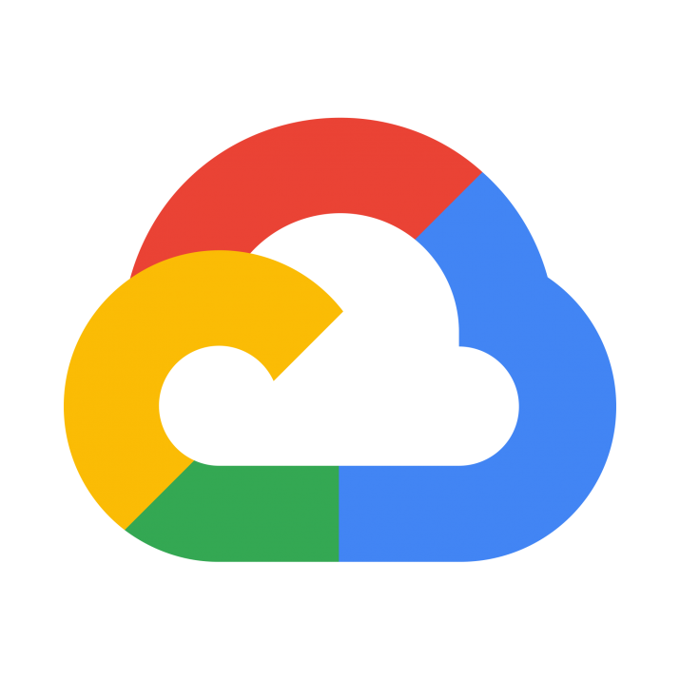
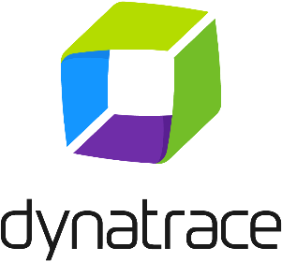
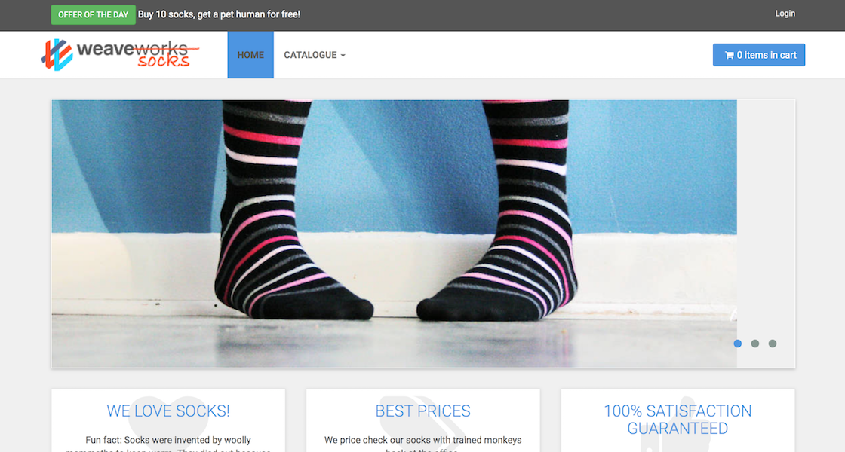



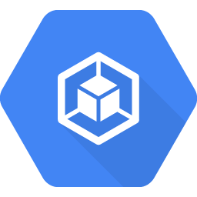


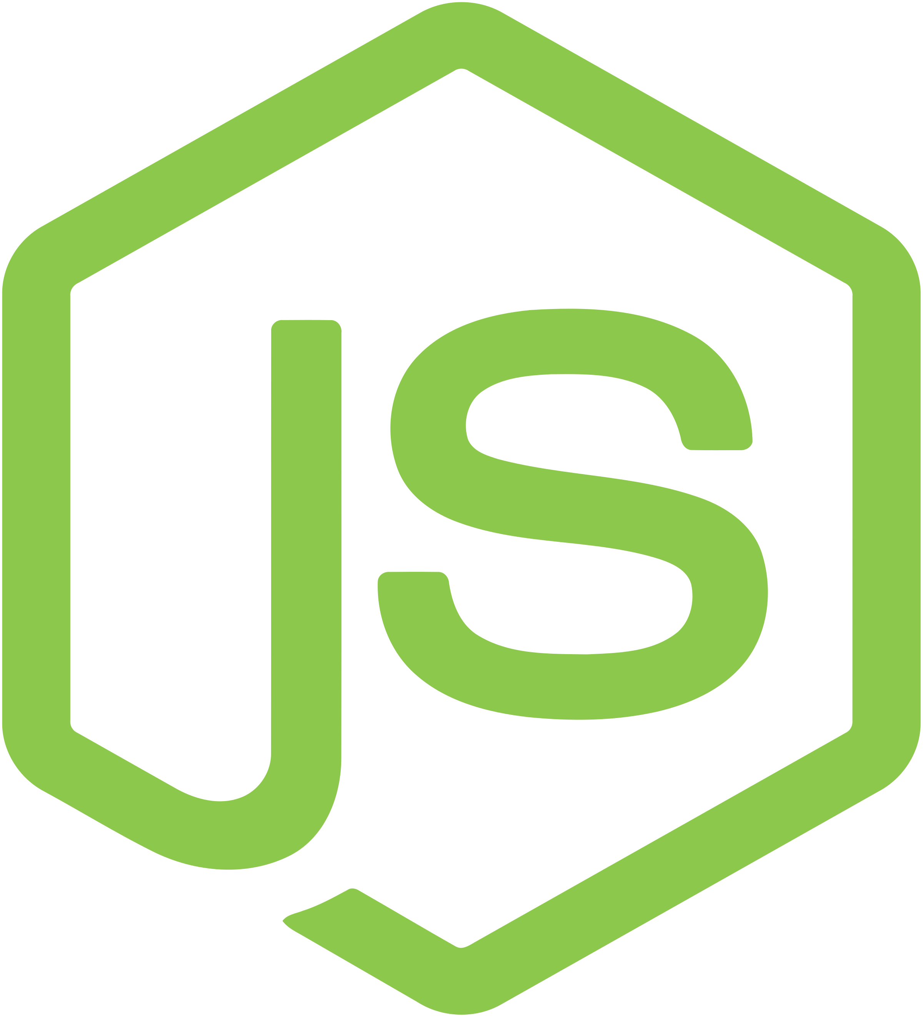


Workshop Setup
#1 Create Dynatrace Tenant
Sample App
GitHub Repository
#2 Download Repo
#3 Deploy Artifacts
Ansible Tower
Every participant
On a laptop (or via CloudShell)
kubectl
Jenkins
GKE cluster

Slide 6
Let’s start the fun : Self-service monitoring

Slide 7
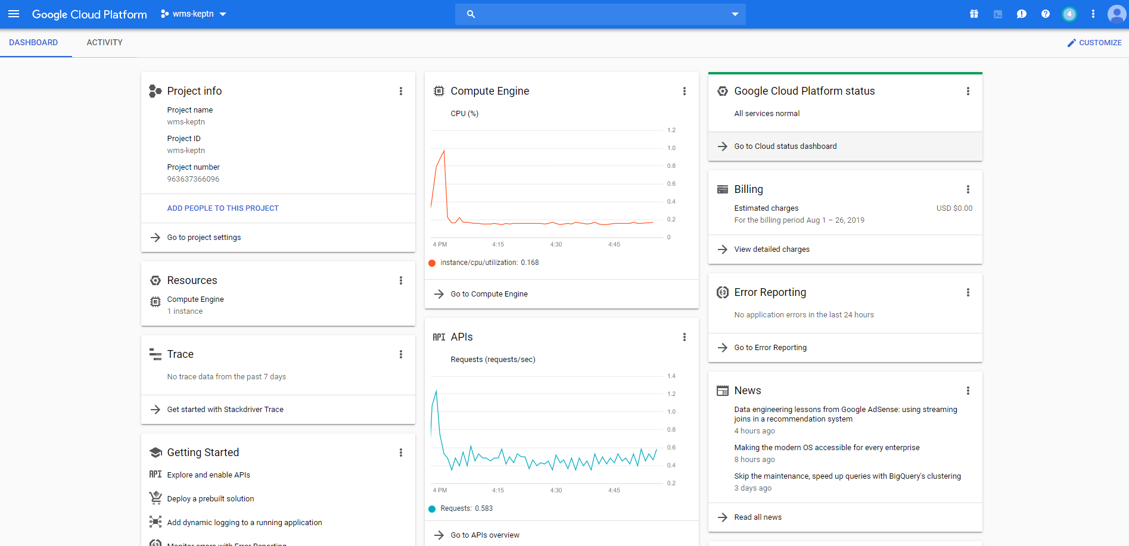
Setup our GCP environment
Log in to your GCP Account

Slide 8
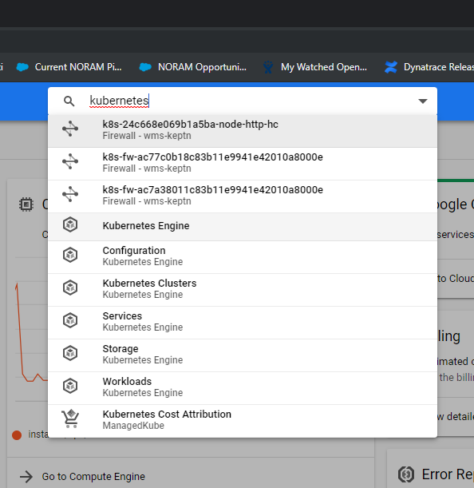
Setup our GCP environment
In the search box, type “Kubernetes” and select
“Kubernetes Engine” from the search results
This may take a few minutes if this is the first time you
are attempting to launch Kubernetes in this account.

Slide 9
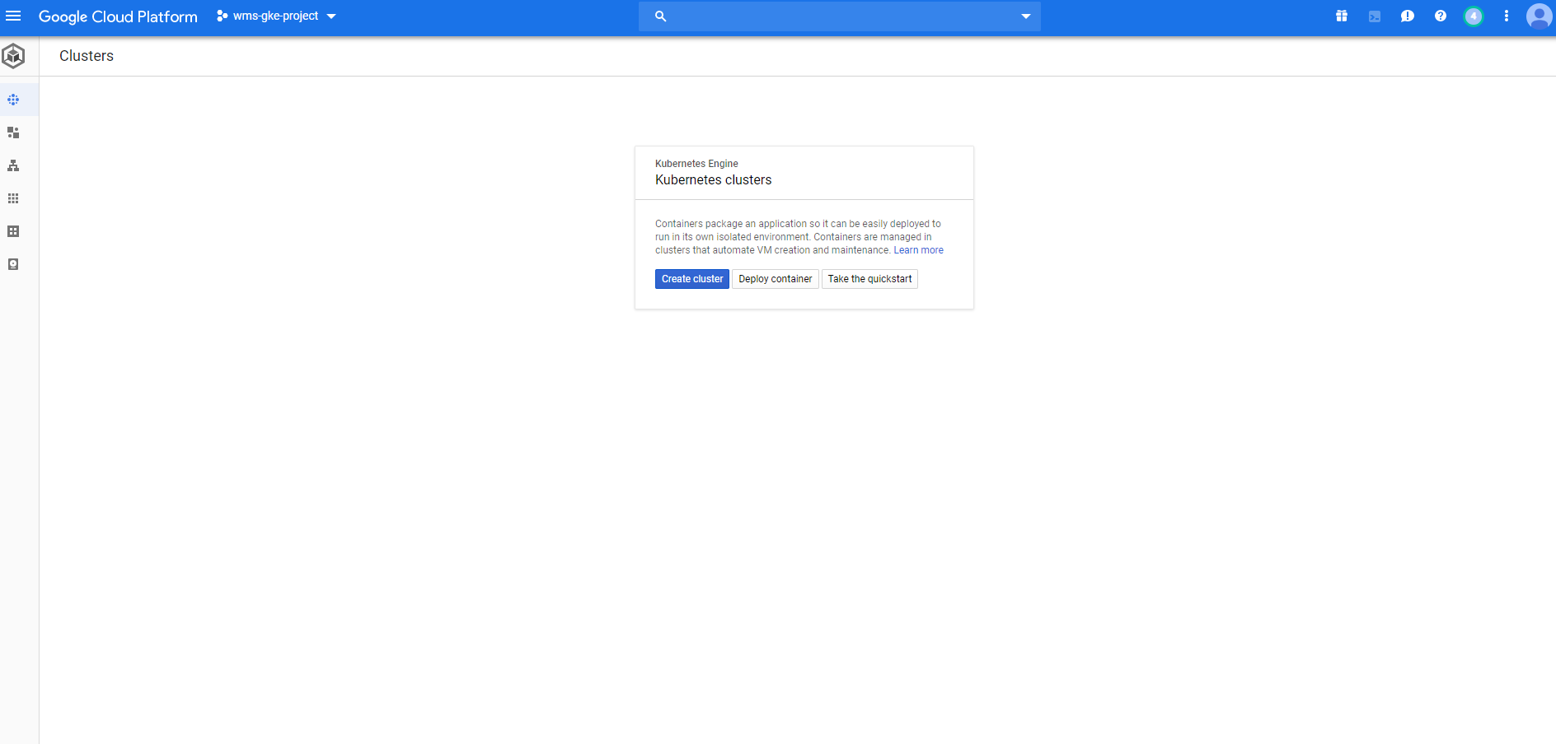
Setup our GCP environment
After the initial APIs are setup, your Kubernetes Engine screen should look like this (unless you already have an existing cluster setup)

Slide 10

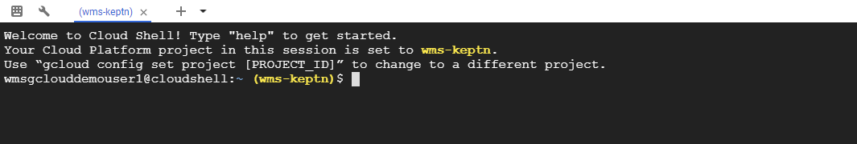
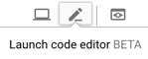
Setup our GCP environment – Launching Cloud Shell
To launch and interact with our Kubernetes cluster we will use Cloud Shell
Cloud Shell provides command-line access to your cloud resources directly from your browser
No need for a separate bastion host
Required tools pre-installed (git, docker, kubectl, etc…)
Persistent storage
From Cloud Shell, you can also access Code Editor
Essentially a text editor with code syntax highlight
Using Code Editor means you don’t need to be a vi expert ☺

Slide 11
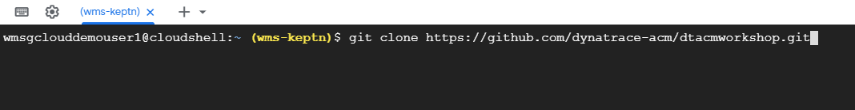
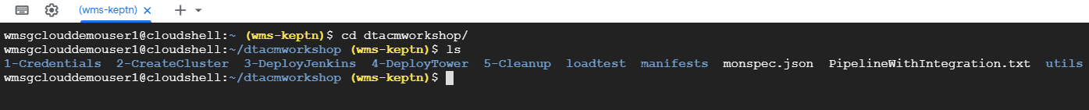
Setup our GKE Cluster – Cloning our repository
In Cloud Shell, clone/download the following GitHub Repository:
# git clone -b v2.2 https://github.com/dynatrace-acm/dtacmworkshop
This will create a directory called dtacmworkshop
This directory contains the scripts we will use for the remainder of the workshop
Notes:
git clone -b v2.2 https://github.com/dynatrace-acm/dtacmworkshop

Slide 12
Dynatrace Credentials – Tenant ID & Environment ID
In order to proceed further we need to make note of our Dynatrace Tenant/Environment and API/PaaS Tokens
For the Tenant ID, you can find it in the first part of your URL
https://<TENANT_ID>.live.dynatrace.com – SaaS Deployments
For example, for https://jwx05250.live.dynatrace.com , Tenant ID=jwx05250
Notes:
SaaS-only

Slide 13
Dynatrace Credentials – Tenant ID & Environment ID
In order to proceed further we need to make note of our Dynatrace Tenant/Environment and API/PaaS Tokens
For the Tenant ID, you can find it in the first part of your URL
https://<TENANT_ID>.dynatrace-managed.com
For example, for https://abc123.Dynatrace-managed.com, Tenant ID=abc123
The Environment ID is only applicable for Dynatrace Managed Deployments. You can find this value in the second half of your URL
https://<TENANT_ID>.dynatrace-managed.com/e/<ENVIRONMENT_ID>
For example, for https://abc1234.Dynatrace-managed.com/e/1234-5678, Environment ID=1234-5678
Notes:
Managed-only

Slide 14
Dynatrace Credentials – Tenant ID & Environment ID
In order to proceed further we need to make note of our Dynatrace Tenant/Environment and API/PaaS Tokens
For the Tenant ID, you can find it in the first part of your URL
https://<TENANT_ID>.live.dynatrace.com – SaaS Deployments
For example, for https://jwx05250.live.dynatrace.com , Tenant ID=jwx05250
https://<TENANT_ID>.dynatrace-managed.com
For example, for https://abc123.Dynatrace-managed.com, Tenant ID=abc123
The Environment ID is only applicable for Dynatrace Managed Deployments. You can find this value in the second half of your URL
https://<TENANT_ID>.dynatrace-managed.com/e/<ENVIRONMENT_ID>
For example, for https://abc1234.Dynatrace-managed.com/e/1234-5678, Environment ID=1234-5678
Notes:
Both SaaS and Managed

Slide 15
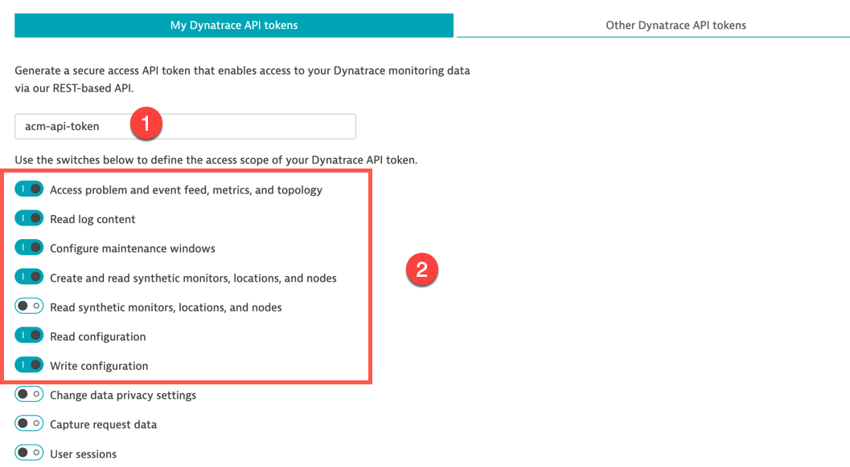
Dynatrace Credentials – API Token
Go in Settings -> Integration -> Dynatrace API
Click on Generate Token
Enter a name for your token (2)
On top of the default switches, turn on the following (3) :
Create and read synthetics monitors
Read configuration
Write configuration
Don't forget to click on the Save button (scroll down to the bottom)

Slide 16
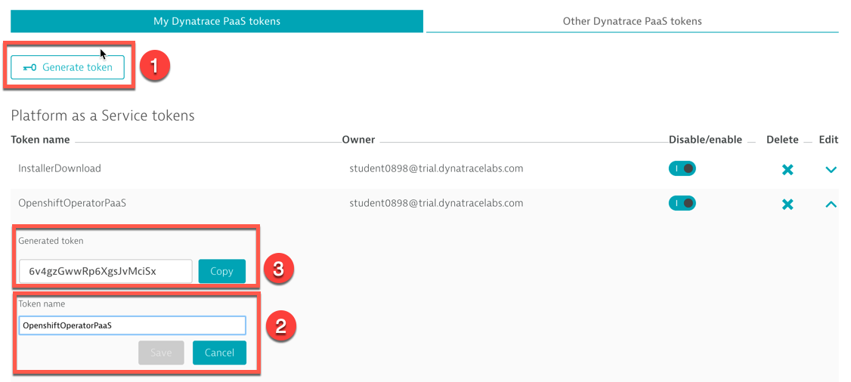
Dynatrace Credentials – PaaS Token
Go in Settings -> Integration -> Platform as a Service
Either copy the existing InstallerDownload token or click on Generate Token
Enter a name for your token (e.g. GKE), click Save

Slide 17
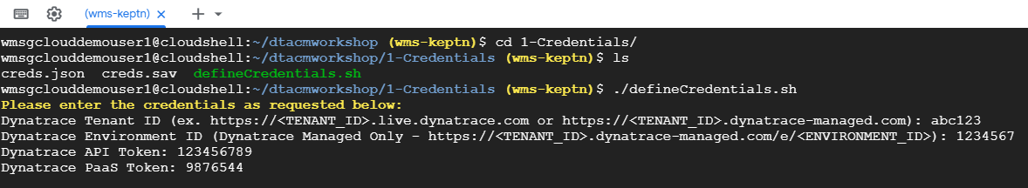
Creating our Credentials
We now need to store a local copy of our Dynatrace Tenant and API info for use when creating our cluster
Navigate to the directory 1-Credentials and execute the script defineCredentials.sh
This will ask for your Dynatrace Tenant/Environment information as well as your API and PaaS tokens
These values can be obtained from your Dynatrace tenant (see previous slides)
If you use a SaaS tenant, just hit enter (blank) when asked for Environment ID
Once you have entered the values and confirmed they are correct, we can move on to creating our cluster

Slide 18
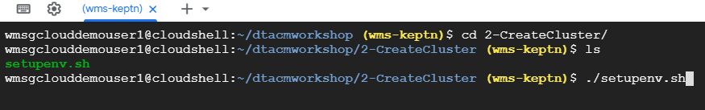
Setup our GKE Cluster
From your Cloudshell session
Navigate to the directory 2-CreateCluster
Execute the script setupenv.sh and confirm that your credentials are correct
This step will take about 15 minutes to complete

Slide 19
Setup our GKE Cluster
The setupenv.sh script will do the following:
Create a new GKE cluster
Deploy the Dynatrace OneAgent Operator to the cluster
Deploy the SockShop application to our cluster
Including creating the required namespaces, pods, storage objects and load balancers

Slide 20
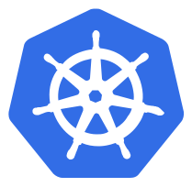
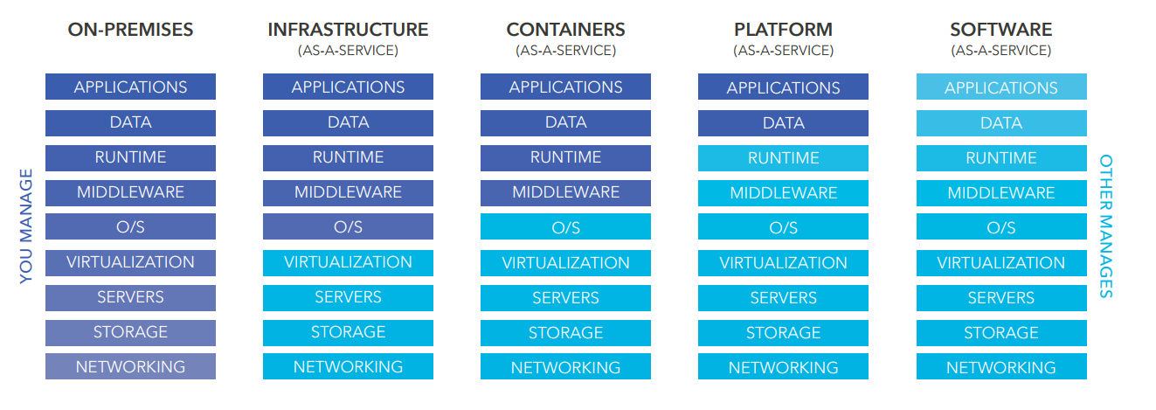
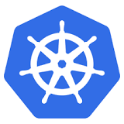
What is Kubernetes?
Notes:
Cloud service models: iaas, paas, saas
IaaS : provides infrastructure building blocks (VMs, VLANs, etc)
PaaS : provides development and software lifecycle management environment
CaaS could be placed between IaaS and PaaS.
CaaS vs IaaS, you don‘t manage or have to be concerned about the OS-level. No need to be a Linux sysadmin.
CaaS vs PaaS, with PaaS, you only deploy your app (code) and the platform will run it (example : Pivotal Cloud Foundry). Paas : more opinionated platforms, less concern for the developer but also less flexibility.

Slide 21
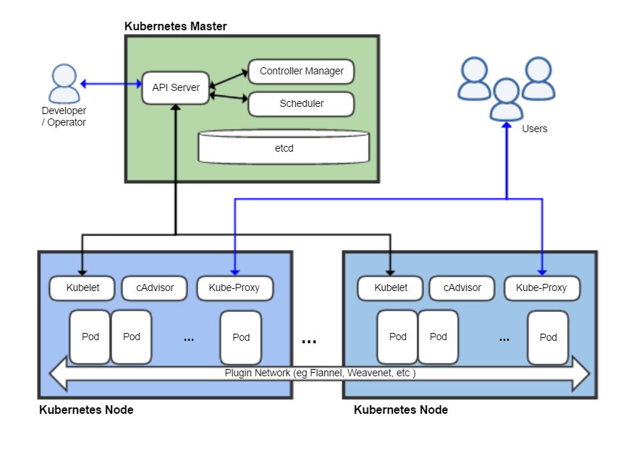
Kubernetes Architecture
Notes:
Masters act as the primary control plane for Kubernetes, which are responsible for running the API server, scheduler and controller manager. Etcd acts and the cluster datastore .
Nodes run a minimal agent that manages the node. Nodes execute workloads as designated by the master.
With GKE, the master node is managed by GCP. We‘re not really concerned by the control plane, our focus today is on monitoring the workload
How is Dynatrace deployed in Kubernetes?

Slide 22
Kubernetes Key Concepts Cheat sheet
Nodes are instances of underlying OS (typically Linux) virtual or physical machine (bare-metal k8s) host one to many Pods | Deployments/Replicasets select a Pod object using labels ensure a given number of Pod replicas handle scale-up/down and rolling updates
Pods are (co-located) groups of containers a Pod’s containers run on the same host (node) | Daemonset ensure that all nodes (optionally matching certain criteria) will run one (and only one) instance of the supplied Pod Suitable for monitoring, log collection, cluster storage
Labels assign identifying metadata to objects (Pods) are used to organize, group or select objects | Services select a Pod object using labels abstract a (replicated) set of Pods by IP, port(s) provide domain name and simple load balancing
Annotations assign non-identifying metadata to objects are used for arbitrary data (build, debug info) | Kubernetes concepts also available from the CLI: $ kubectl api-resources
Notes:
Replace ingress by daemonset

Slide 23
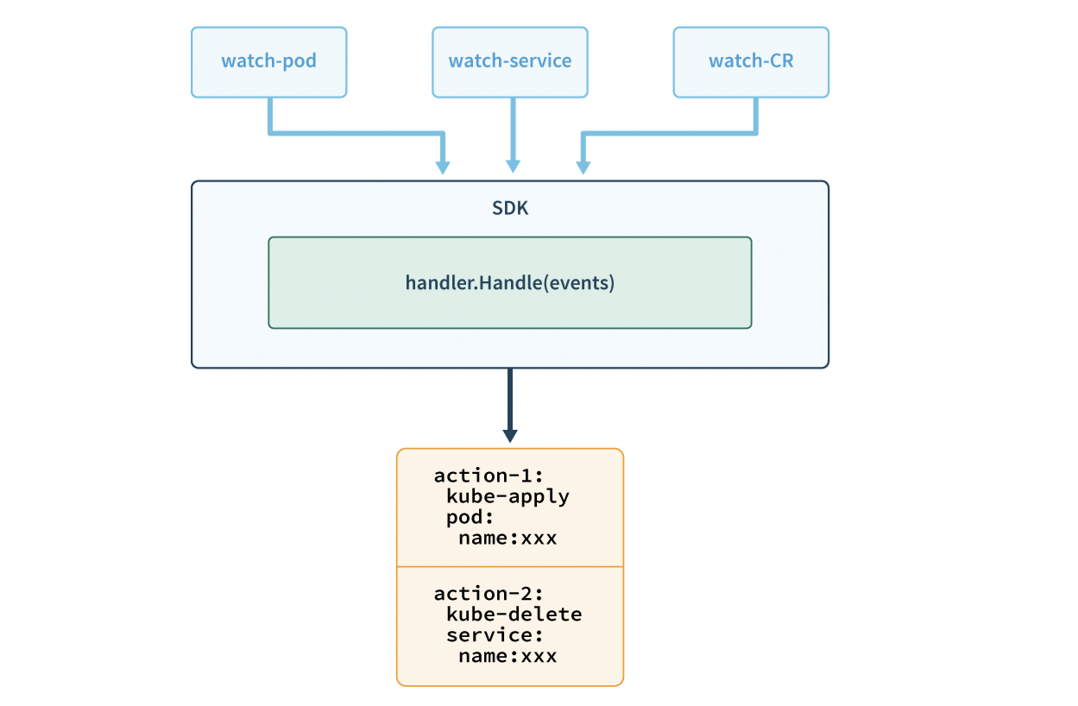
What is an Operator?
The Operator Framework is an open source toolkit to manage Kubernetes native applications in an effective, automated, and scalable way.
Human operational knowledge in software
Reliably manage application lifecycles as a first-class kube native object

Slide 24
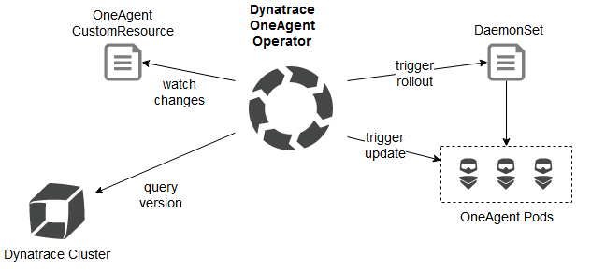
OneAgent Operator in action
1
Watches for custom resources of type OneAgent
Takes care of OneAgent deployment via DaemonSet
Updates OneAgent to the latest version available
1
2
2
3
3
3

Slide 25
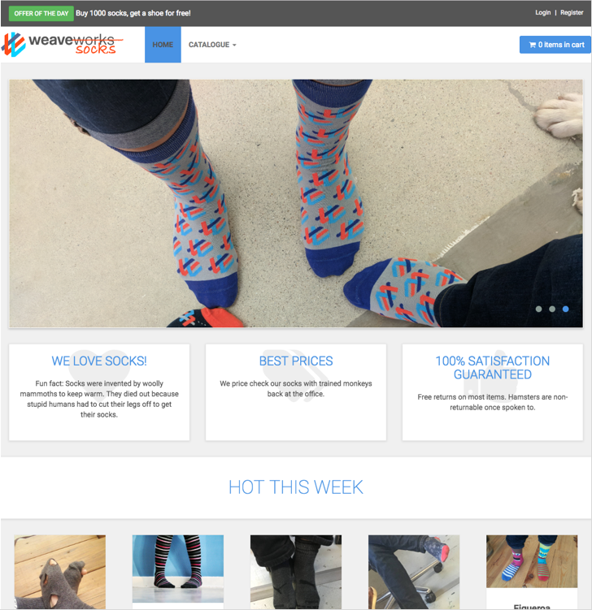
Sock Shop Application
Based on: http://socks.weave.works
Opensource microservice sample app
Polyglot
Java Spring Boot
Go
Node.js
RabbitMQ (order queuing)
MongoDB, MySQL (data stores)

Slide 26
Sock Shop architecture

Slide 27
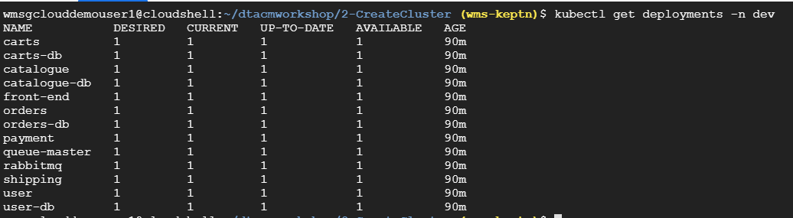
Validate our Cluster setup
After about 10 minutes since running the setupenv.sh script, let’s verify that everything is up and running
Let’s check and make sure our Deployments are Ready, run the following command in Cloudshell:
$ kubectl get deployment -n dev -o wide
Note: This can also be validated in the GKE Console by selecting “Workloads” from the menu on the left side of the screen

Slide 28
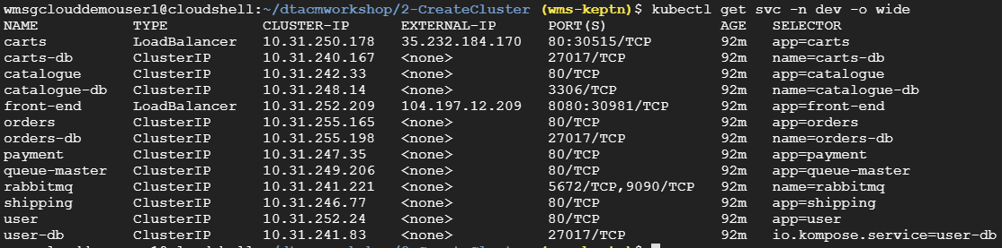
Validate our Cluster setup
Lets ensure that the SockShop application services are also created by running the following command:
$ kubectl get svc -n dev -o wide
Our Carts and Front-end services should have External-IP addresses assigned
Note: This can also be validated in the GKE Console by selecting “Services & Ingress” from the menu on the left side of the screen

Slide 29
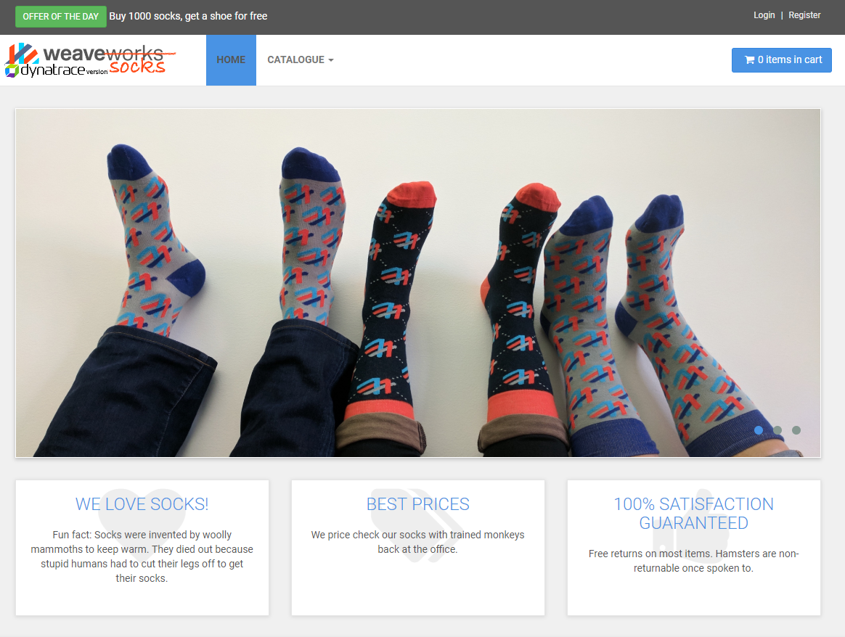
Validate our Cluster setup
Let’s launch our application in a web browser by copying and pasting the External-IP and Port of the front-end service. In the previous example it would be: http://104.197.12.209:8080
This information should also be available in the configs.txt file in the utils directory
$ cat ../utils/configs.txt
The SockShop homepage should appear in your browser
You can click around and log in with the following user:
username : acm
password : 1234

Slide 30
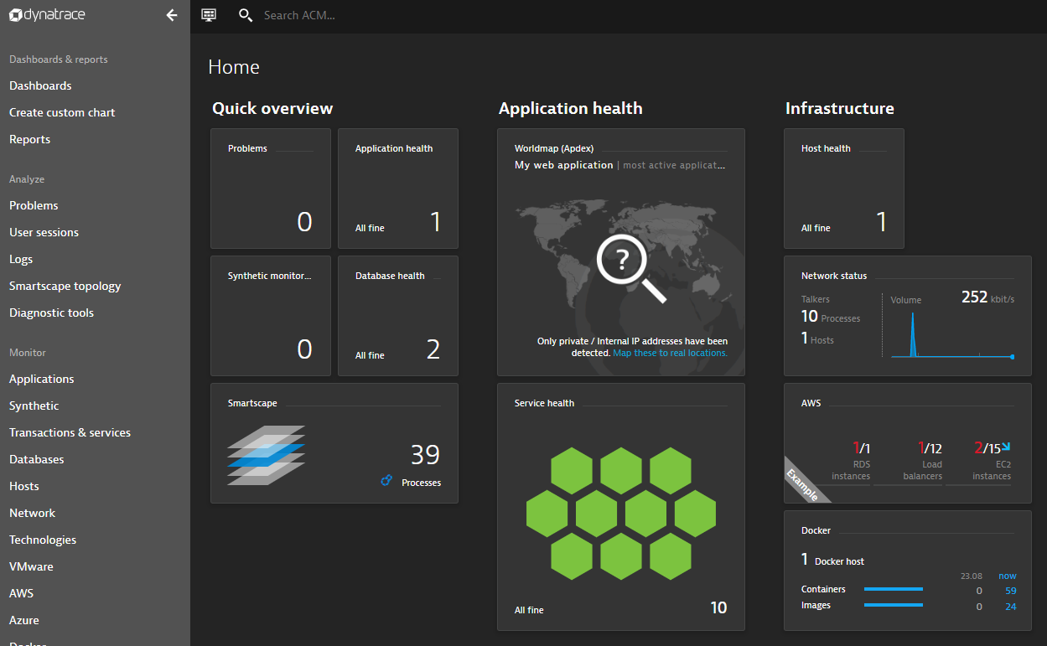
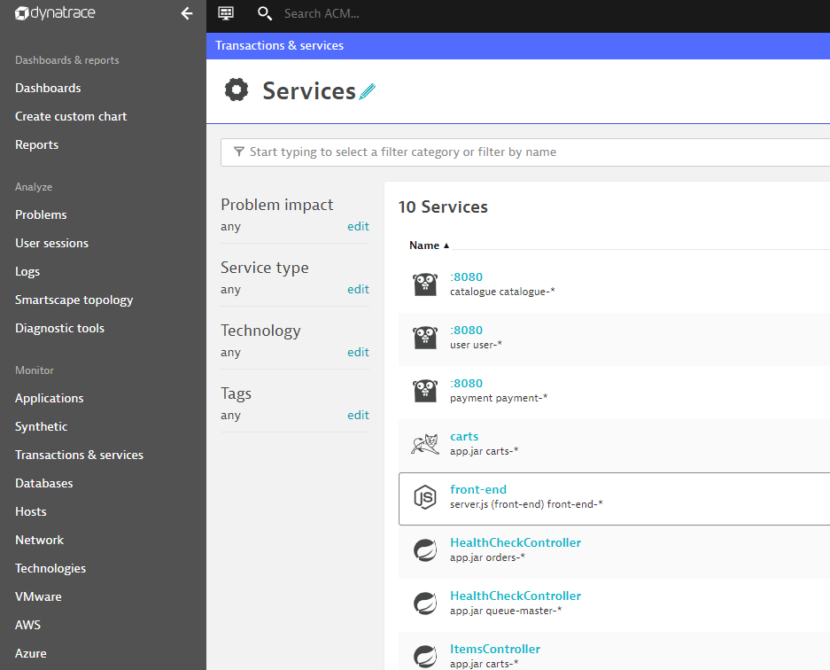
Validate Dynatrace
Now that we know our application is deployed and running successfully, we can validate that everything is being displayed in Dynatrace
Navigate back to Dynatrace and you should see data for Host, Process and Services

Slide 31
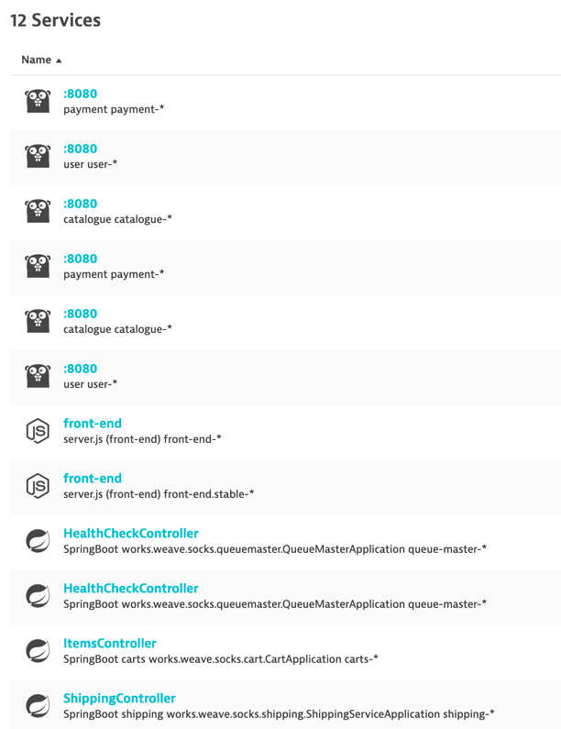
Structure services according to our needs
All services are listed together, how to differentiate those in dev than those in production?
The services naming is not helping much either
To make this more usable, we will leverage
Management Zones
Custom Service Naming Rules

Slide 32
Management Zones
What it is :
A concept to group parts of an environment together
Each entity can be part of any number of management zones
It allows users to focus on one management zone by filtering all views
Dashboards, list views and Smartscape can be filtered (global search)
Fine grained role-based access control
Access rights can be granted either to a full environment or to a number of Management Zones

Slide 33
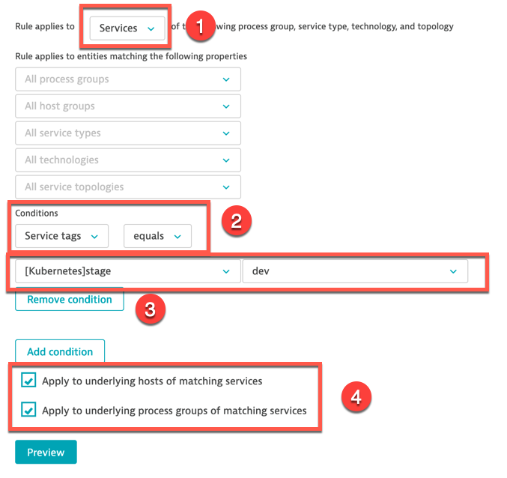
Create Management Zones for dev and prod
Go in Settings -> Preferences -> Management Zones. Click Add Management Zones.
Enter a name, example : dev
Click Add a new rule
(1) Apply the rule to Services
(2) The condition is “Service tags equals”
(3) The service tag is “[Kubernetes]stage” and the value of the tag is “dev”
(4) Apply the rule to underlying process groups and hosts
Don’t forget to save

Slide 34
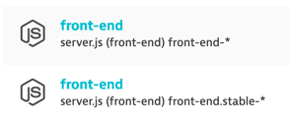
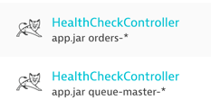
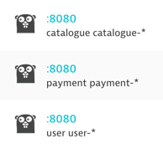
Service Naming
With these Service names, how do you know:
Which service is running in a pod on Kubernetes?
Which one is not, outside of Kubernetes?
Which one is production? Which one is dev?
I have duplicate names even though they are different services
What can I do with a service called ":8080"?

Slide 35
Custom Service Naming
What we want to achieve a similar result with services, showing up with naming that tells us:
Whether the services are in Kubernetes or not. Have service name start with ”k8s" for those in Kubernetes.
What project is the service part of. Your company likely has multiple projects running in the same cluster.
The service namespace, which in our case with Sock Shop also tells us if it's production or dev.
The container name, which correspond to our microservice name
Target service naming : k8s-project-namespace-container
Let's apply that configuration in Dynatrace!

Slide 36
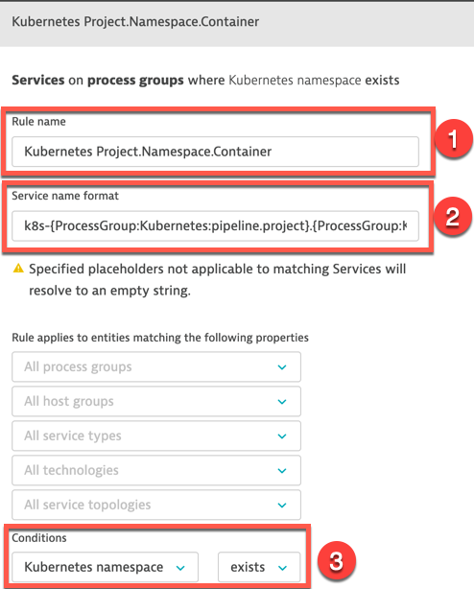
Create Custom Service Naming Rules
Go in Settings -> Server-side service monitoring -> Service naming rules and click Add a new rule
Provide a name to the rule, for example : Kubernetes Project.Namespace.Container
In the conditions drop-down, select the property "Kubernetes namespace" and the condition "exists"
For the name format, we can enter free text and/or use placeholders.
A list of available placeholder is displayed as you type.
Placeholders are in between brackets {} to distinguish from free text
Enter this format : k8s-{ProcessGroup:Kubernetes:pipeline.project}.{ProcessGroup:KubernetesNamespace}.{ProcessGroup:KubernetesContainerName} {Service:WebServiceName}
You can preview to see the results
Don’t forget to save
Notes:
k8s-{ProcessGroup:Kubernetes:pipeline.project}.{ProcessGroup:KubernetesNamespace}.{ProcessGroup:KubernetesContainerName} {Service:WebServiceName}

Slide 37
Shift-left : Deploying Jenkins

Slide 38
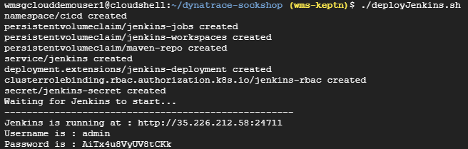
Deploy Jenkins
In Terminal/Cloudshell execute the script: deployJenkins.sh in the directory 3-DeployJenkins
This will deploy and startup Jenkins, import our pipeline and output the credentials

Slide 39
What is Jenkins?
The world’s most advanced BASH terminal
Automate the non-human part of the software development process
that is everything related to building, testing and deploying your applications
In most cases it’s fine to deploy to k8s via simple kubectl commands
Most of deployments probably done this way
Spoiler alert: We’re not going to be doing this today
No true “easy” way to determine a failure or if app is up and running
$kubectl wait –n dev deploy/myapp –-for condition=available
This won’t catch pods that didn’t actually come online
Notes:
What is Jenkins? Well Jenkins is the most commonly used Continuous Integration and Deployment (CI/CD) tool.
You can think of Jenkins as a glorified bash terminal.
It’s purpose is all about automation of the non-human part of the software development process,
that is everything related to building, testing and deploying your applications.

Slide 40
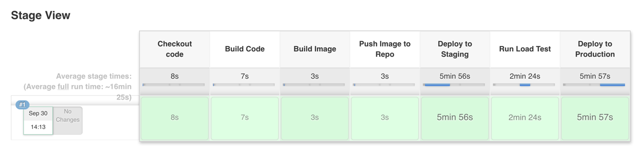
What our initial Pipeline for the carts service looks like

Slide 41
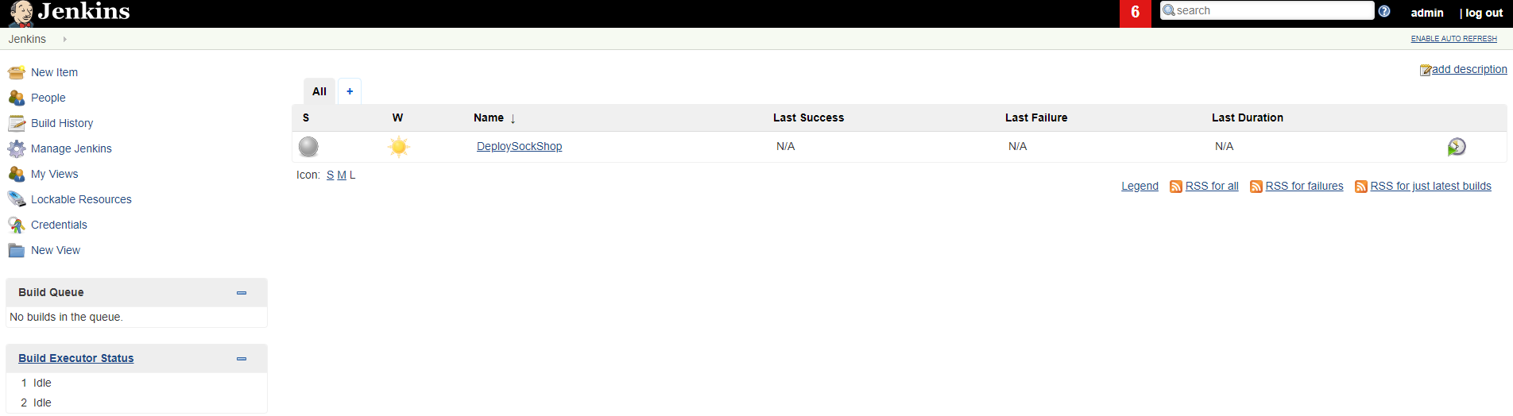
Jenkins Setup
After Jenkins has successfully deployed, navigate to the Jenkins URL
Login with the previously provided username and password

Slide 42
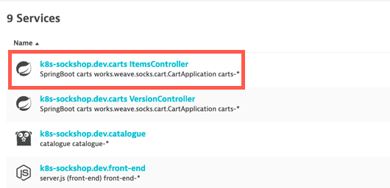
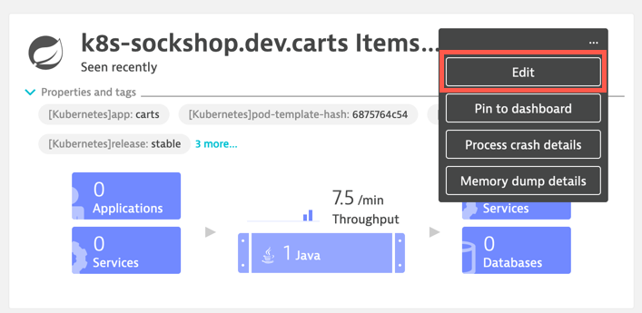
Disabling anomaly detection in dev (1)
Dev and tests environments are not stable; load and testing conditions vary over time
Thus Dynatrace automated baselining and anomaly detections may not be a good fit in such environments.
we’ll see later mechanisms more suitable to validate builds in the delivery pipeline.
So, we will disable anomaly detection for the carts ItemsController service in the dev namespace
In the Transactions and Services view, drill down to the dev carts ItemsController service
Click on the ellipsis (…) button and then Edit

Slide 43
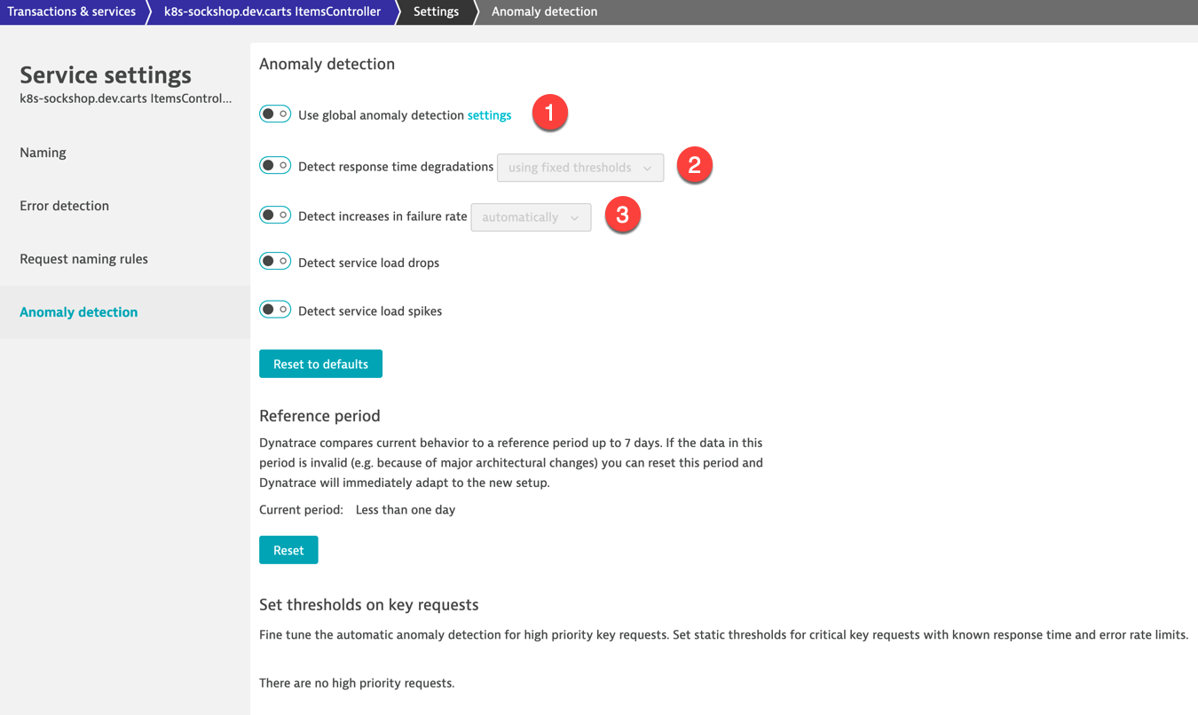
Disabling anomaly detection in dev (2)
Go to Anomaly detection
Switch off:
Use global anomaly detection settings (1)
Detect response time degradations (2)
Detect increases in failure rate (3)

Slide 44
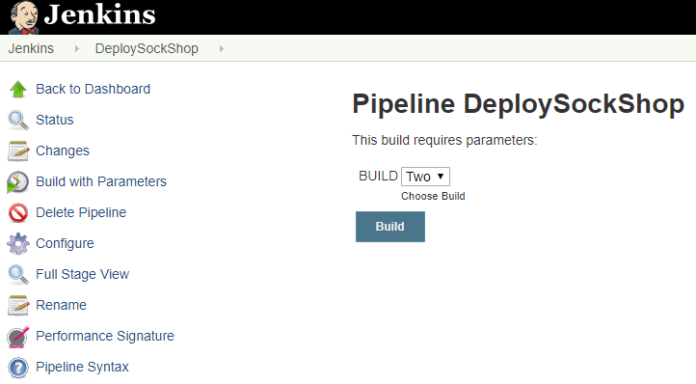
Let’s now deploy a new build
We currently have build One running (when we deployed the environment)
The team has been working on a new build (build Two) that is ready to go through our pipeline.
Select Build “Two” and Build

Slide 45
If all goes well…
The pipeline should run successfully (Note: this will take about 15 minutes)

Slide 46
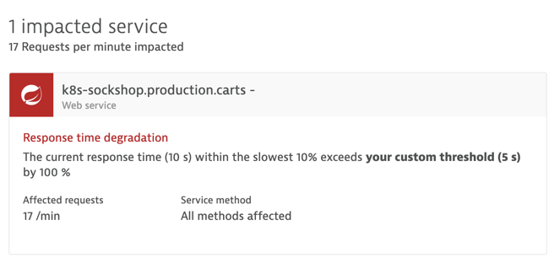
But is this really the case?
Dynatrace detected a problem related to the cart service in production
How that build managed to get deployed in production?
How do we know when that build was deployed in production? When was it tested in dev?
Jenkins has this information, but we need it in Dynatrace too

Slide 47
What is missing?
We have an automated delivery and deployment pipeline
We have monitoring of the pipeline, including the performance testing
BUT we need someone to:
take a look at the tests results
make an assessment
manually stop the build
Continuous delivery : we need this to be automated
Answer : Monitoring-as-code (performance signature) check as a Quality Gate integrated in our pipeline
If test results don’t comply, stop the build automatically
Also : have Jenkins notifies Dynatrace when builds are deployed throughout different stages (dev, prod)

Slide 48
Shift-Left & Shift-Right : Jenkins-Dynatrace integration

Slide 49
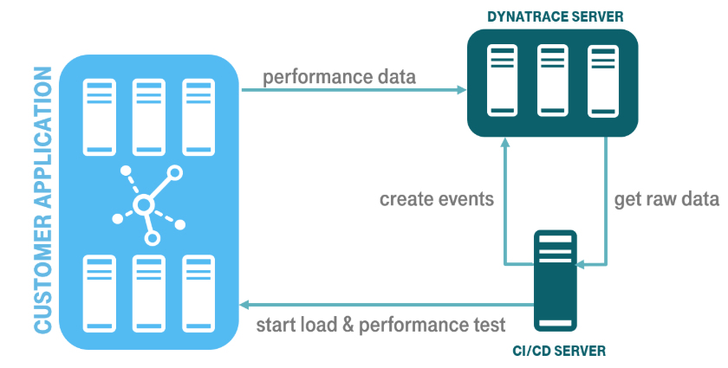
Dynatrace Integration
Blog post: https://www.dynatrace.com/news/blog/shift-left-in-jenkins-how-to-implement-performance-signature-with-dynatrace/
Integration via the Dynatrace APIs (Timeseries and Events)
Based on a Performance Signature of a release (monspec)

Slide 50
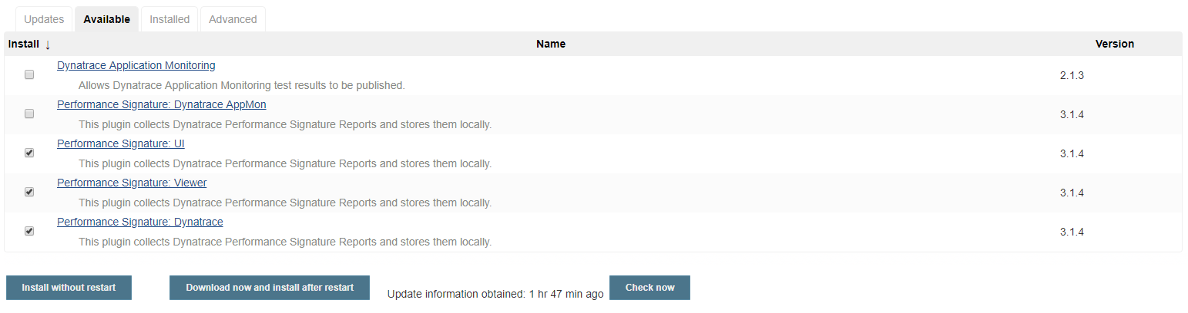
Install Jenkins Plugin
Navigate to Manage Jenkins -> Manage Plugins page and switch to the Available tab. Search for the "Dynatrace" keyword, select the 3 options below and click “Install without restart”.
Restart Jenkins : http://<IP_ADDRESS>:24711/restart
More details on these plugins : https://github.com/jenkinsci/performance-signature-dynatrace-plugin/blob/master/viewer/README.md
Notes:
Viewer plugin : https://github.com/jenkinsci/performance-signature-dynatrace-plugin/blob/master/viewer/README.md

Slide 51
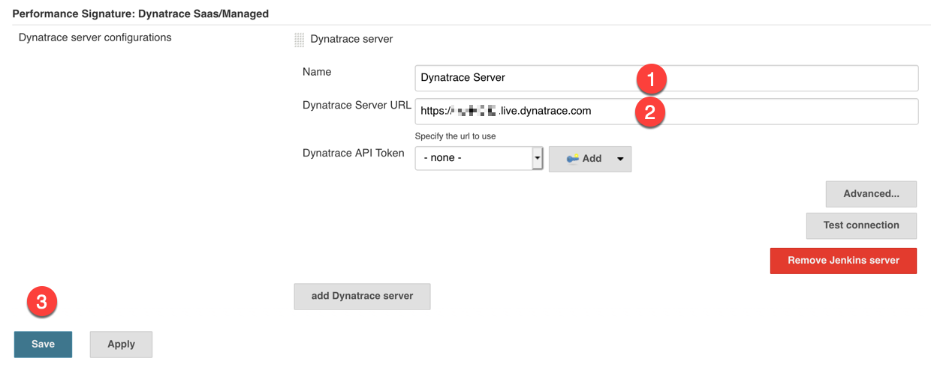
Jenkins Configuration (1)
Navigate to Manage Jenkins -> Configure System -> Performance Signature: Dynatrace SaaS/Managed
Enter the following in Name: Dynatrace Server (1)
Your Tenant URL (2)
(https://xxxxxxxx.live.dynatrace.com) – SaaS, (https://asdfa.dynatrace-managed.com/e/asdfafa) - Managed
You will need to Save (3) and exit this screen and come back for the “Add” dropdown to works, thanks to a bug in Jenkin

Slide 52
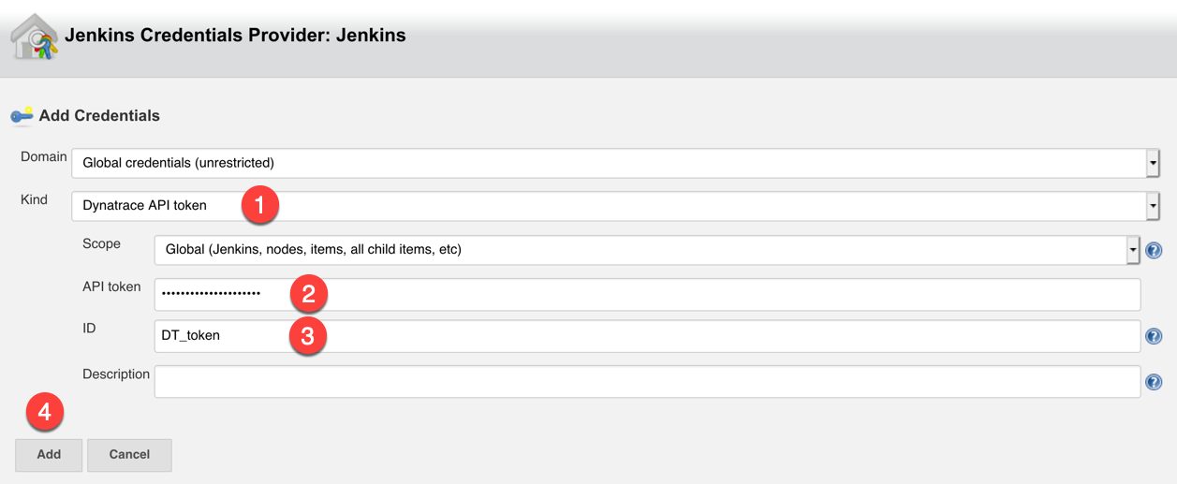
Jenkins Configuration (2)
Click the Add button
Select the kind of credential : Dynatrace API token (1)
Enter the value of your API token (2)
Enter a name of your choice in the ID field (3)
Click Add (4)

Slide 53
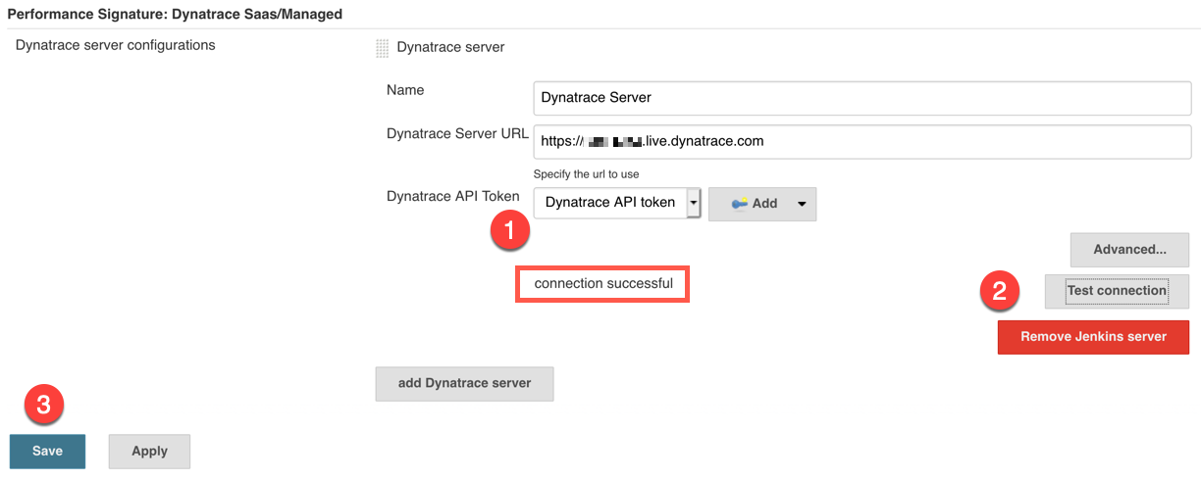
Jenkins Configuration (3)
Select Dynatrace API token (1)
Test connection (2) - should be successful ☺
Save the configuration (3)

Slide 54
Adding Events to our Pipeline
There are three main events we will be adding to our Deployment Pipeline:
createDynatraceDeploymentEvent – Sends the Deployment Event to Dynatrace
recordDynatrace Session – Sets start/end time for when performance test begins and ends
perfSigDynatraceReports – Queries all the metrics during the perf test timeframe and compares against the spec file. If metrics violate the spec file, the pipeline stage is failed

Slide 55
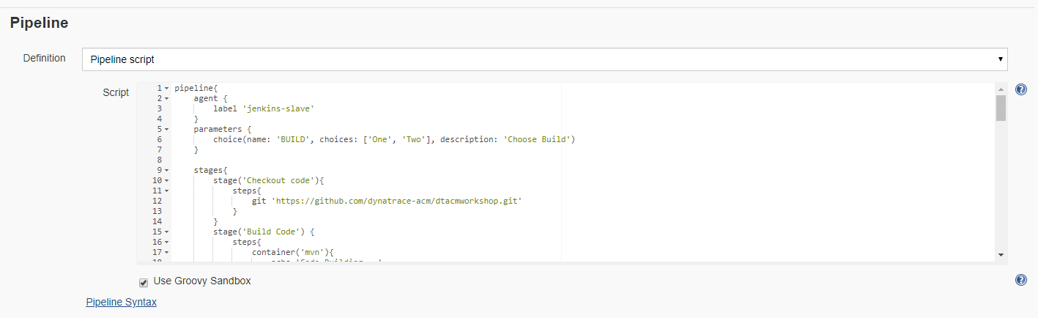
Adding Events to our Pipeline
In the DeploySockShop pipeline, click “Configure” and scroll down to the Pipeline script

Slide 56
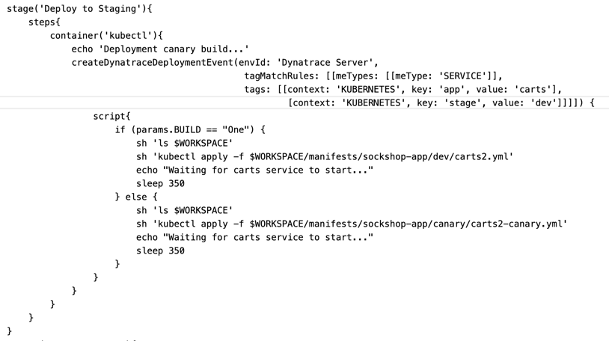
Adding Events to our Pipeline – Deployment Events
First we want to add a Deployment Event to our Pipeline so every time we deploy our build to staging, Dynatrace will know about it

Slide 57
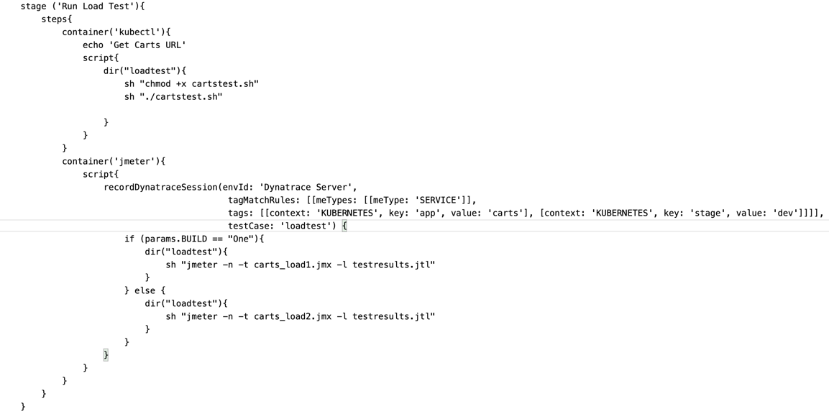
Adding Events to our Pipeline – Record Perf Test
Next we want to wrap our Load Test stage with the recordDynatraceSession function, so we know when testing start and stop

Slide 58

Adding Events to our Pipeline – Compare results to monspec
Add the below stage (“Dynatrace Quality Gate”) in between the “Run Load Test” and the “Deploy to Production” stages

Slide 59
Adding Events to our Pipeline
Once the events are added to our Pipeline we can apply and save
Note: There is a sample Pipeline with the events already added in the root of the repository titled “PipelineWithIntegration.txt”
You can use this as a reference when editing your pipeline
Note: You will need to make sure you change the name of the Dynatrace Environment to the same thing as you named your connection earlier. This file uses the name “Dynatrace Server” as the Dynatrace Environment Name.

Slide 60
Let’s test our integration

Slide 61
Deploy Build Two Again
After updating and saving our Pipeline to include the Dynatrace Performance Events, let’s re-run our pipeline with Build Two
Select Build “Two” and Build

Slide 62
How deployment info is pushed to Dynatrace
This uses the Dynatrace Event API to push CUSTOM_DEPLOYMENT events to Dynatrace
Push an Event to this Dynatrace Tenant
Define Entity Type (=SERVICE) and Tags (app:carts, stage: dev) with Kubernetes context

Slide 63

Tag mappings in the Service view
Looking at the tags for ItemController in dev
Tags matching with createDynatraceDeploymentEvent in Jenkins pipeline definition
Service with tags :
[Kubernetes]app : carts
[Kubernetes]stage : dev

Slide 64
How performance perf test info is pushed to Dynatrace
This uses the Dynatrace Event API to push CUSTOM_INFO events to Dynatrace

Slide 65
Performance Signature validation
After the load test is completed, we validate the test against our monspec file (see next slide), to determine if our build meets quality or not

Slide 66
Sample Monspec File
{
"spec_version": "2.0",
"timeseries": [{
"timeseriesId": "com.dynatrace.builtin:service.responsetime",
"aggregation": "avg",
"tags": “[Kubernetes]app:carts,[Kubernetes]stage:dev",
"upperWarning": 1000,
"upperSevere": 3000
}
]
}
specify entities by tags
fails the build if limits are exceeded
Refer to Time Series API doc for available timeSeriesId and aggregations : https://www.dynatrace.com/support/help/shortlink/api-metrics

Slide 67
Performance Signature Definition – Upper and Lower Limit
Response Time
Throughput
Upper Severe
Upper Warning
Lower Warning
Lower Severe
→ Warning Limit raises a Warning (i.e., unstable Jenkins build)
→ Severe Limit raises a Failure (i.e., failed Jenkins build)

Slide 68
Other potential quality gates & metrics
Check 2
New dependencies? On Purpose?
Services connecting accurately?
Number of container instances needed?
Check 3
Are we jeopardizing our SLAs?
Does load balancing work?
Difference between Canaries?
Check 1
Bad coding leading to higher costs?
Metrics
Memory usage
Bytes sent / received
Overall CPU
CPU per transaction type
Check 4
Did we introduce new “hidden” exceptions?
Metrics
Number of incoming / outgoing dependencies
Number of instances running on containers
Metrics
Response Time (Percentiles)
Throughput & Perf per Instance / Canary
Metrics
Total Exceptions
Exceptions by Class & Service

Slide 69

Now our Build Two should fail at the Quality Gate

Slide 70


Deployment and Performance Signature check events
In Dynatrace, return to the carts ItemController service in dev.
You should now see events displaying when builds are deployed in dev and when they have been tested (performance signature)

Slide 71

Deliver good build to production
If we redeploy using Build #1, this build should pass our Dynatrace Quality Gate
Select Build “One” and Build

Slide 72

Production Deployment event
In Dynatrace, return to the carts ItemController service in prod.
You should now see events displaying when builds are deployed in prod

Slide 73
Auto-remediation with Ansible Tower

Slide 74



Ansible and Ansible Tower
Runbook – definition: a compilation of routine procedures and operations that the system operator (administrator) carries out
Ansible
Simple automation language + automation engine
Human readable (yaml)
Ansible Tower
Web UI
Management of runbooks
Powerful API for automation
Notes:
A runbook is a compilation of routine procedures and operations that the system administrator or operator carries out.
Ansible is an open source IT configuration management, deployment, and orchestration tool. Ansible uses YAML syntax for Ansible playbooks. YAML is used because it is very easy for humans to understand, read and write.
Ansible Tower is the web UI and dashboard for Ansible. It automates and presents tasks graphically, especially the monitoring and dashboard types of tasks.

Slide 75

Deploy Ansible Tower
In Terminal/Cloudshell execute the script: deployTower.sh in the directory 4-DeployTower
This will deploy and startup Ansible Tower. This will also configure Tower, import projects, inventories, credentials (DT API token) and playbook templates.
Take a note of the Ansible Job URL displayed by the script. You will need it for a next step.

Slide 76

Promotional campaign
We’ll be implementing a promotional campaign for our socks
This promotion will be randomly available to customers
The carts service has an endpoint allowing us to provide the percentage of users that will benefit from the promotional gift
The problem is that the promotion implementation is defective ☹
Nobody knows about it yet and this could potentially have disastrous effect on the brand and business reputation
Notes:
We’ll be implementing this use case with the carts service, since this feature is already implemented. The carts service includes the endpoint carts/1/items/promotional/ that can take a numeric input value, the percentages of user interactions that will receive the promotional gift. For example, say 5% of users.
Therefore, we can easily change the behavior of our carts service at runtime. However, changing the value without using a configuration management system would not allow us to track when changes happened and which configuration values have changed. So, that’s why we are using Ansible Tower to execute changes in our configuration.

Slide 77



Runbook automation workflow
Trigger promotional campaign
with Promotion Rate set to 50 %
Set Promotion Rate to 50 %
Send custom
configuration event
Monitor Sockshop & detects
increase of failure rate
Send problem notification
Set Promotion Rate to 0 %
Send custom
configuration event
Send comment to problem
Notes:
We’ll be implementing this use case with the carts service, since this feature is already implemented. The carts service includes the endpoint carts/1/items/promotional/ that can take a numeric input value, the percentages of user interactions that will receive the promotional gift. For example, say 50% of users.
Therefore, we can easily change the behavior of our carts service at runtime. However, changing the value without using a configuration management system would not allow us to track when changes happened and which configuration values have changed. So, that’s why we are using Ansible Tower to execute changes in our configuration.

Slide 78

Log in the Ansible Tower console
Use the job template URL you copied earlier, without the path, and copy it in your browser to load the Ansible Tower console
For example, if the job template URL was : https://34.69.184.20/#/templates/job_template/35
then the console URL is : https://34.69.184.20
Log in Ansible Tower
username : admin
password : dynatrace
You will be prompted to provide a license file and accept the license agreement
If you don’t already have your license file, click the button to request a free trial license from Red Hat (delivered via email)

Slide 79

Configure Dynatrace Problem Notification
In the Dynatrace UI, navigate to Settings -> Integration -> Problem Notification -> Ansible Tower

Slide 80


Configure Ansible Tower integration
Enter the Ansible Tower job template URL you were provided after the deployment
Enter the credentials to access Ansible
username : admin
password : dynatrace
Click the Sent test notification button to validate your configuration
on success, a green confirmation message will be displayed
Save your configuration

Slide 81


Launch Campaign playbook
Back in the ansible Tower console
From the side menu, navigate to Resources -> Templates
Click on the rocket icon to launch the start-campaign playbook
Hit Next on the prompt popup window and then Launch
As the playbook runs, the output will be displayed. Validate that the recap shows OK=2

Slide 82

Observe the promotional campaign
In the Dynatrace console, navigate to Transactions & Services and drill-down into the production ItemsController service
Tip : filter by tag : [Kubernetes]stage:prod to only display services in production

Slide 83

Observe the promotional campaign
Look at the Service events.
The Start Campaign playbook have notified Dynatrace when the promotional rate was changed to 50%

Slide 84


Observe the promotional campaign
You should see the Failure Rate increasing, eventually leading to Dynatrace detecting a Problem
You might need to refresh your browser a few times

Slide 85

Observe the auto-remediation playbook actions
Go back to the Service view
The comments section will show the remediation actions taken by Ansible Tower

Slide 86

Observe the auto-remediation playbook actions
Drill-down in the Problem.
You will see a new configuration change event reported by Ansible Tower
The promotional rate has been set back to 0% to remediate to the transaction failures

Slide 87

Observe the auto-remediation playbook actions
Jobs executed in Ansible Tower
start-campaign (set rate to 50%)
remediation
push comment to Dynatrace Problem
retrieve problem details
launch remediation action related to problem context
update Dynatrace Problem
stop-campaign (set rate to 0%)

Slide 88

That’s it! Problem solved automatically
Look at the Service Failure Rate. It has returned to 0%

Slide 89
Runbook automation workflow recap
Trigger promotional campaign
with Promotion Rate set to 50 %
Set Promotion Rate to 50 %
Send custom
configuration event
Monitor Sockshop & detects
increase of failure rate
Send problem notification
Set Promotion Rate to 0 %
Send custom
configuration event
Send comment to problem

Slide 90
How to clean up

Slide 91
Clean up
If you want to keep the Kubernetes cluster running but:
remove all workload : execute the script cleanup.sh in the 5-Cleanup directory
only remove Jenkins : execute the script removeJenkins.sh in the utils directory
only remove Ansible Tower : execute the script removeTower.sh in the utils directory
only remove Dynatrace (no!!! ☹) : execute the script delete-dt-operator.sh in the utils directory
It is strongly recommended to disable all synthetic monitors in Dynatrace to avoid consuming all the DEM units from your free trial
If you want to delete everything, delete the GKE cluster via the GCP Console

Slide 92
Summary

Slide 93










Step 1 : Self-service monitoring
Automated Monitoring
Tagging
Dashboards
Alerting

Slide 94






Step 2 : Shift-left
Automated Performance
Integrate
Performance as a Self-Service

Slide 95






Step 3 : Shift-right
Automated Delivery
Integrate
Quality Gates
Staging
Blue/Green
Production

Slide 96








Step 4 : Self-healing
Automated Problem
Remediation
Decide
Application
Evaluate
Act

Slide 97
What are the next steps?
ACM automation services
Best practices and guidance on implementing ACM within your own context
Delivered by Dynatrace consulting services

Slide 98





Automation Services address tangible business challenges
1
2
2
3
4
1
3
4

Slide 99
What are the next steps?
ACM automation services
Best practices and guidance on implementing ACM within your own context
Delivered by Dynatrace consulting services
Autonomous Cloud Labs (ACL)
1-week hands-on training
Cover what we’ve seen during this workshop but gets deeper
Additional topics covered during the week
keptn
Open-source framework to implement ACM
Still in development, GA 1.0 not available yet
More details : http://keptn.sh

